Slide 1
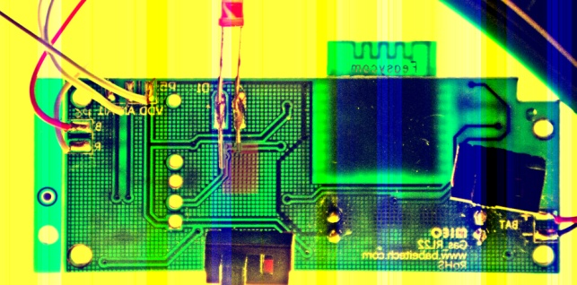
VDD
AI0
AI1
B
R
AI0
B
R
AI1
VDD
Flame King propane scale

Slide 2
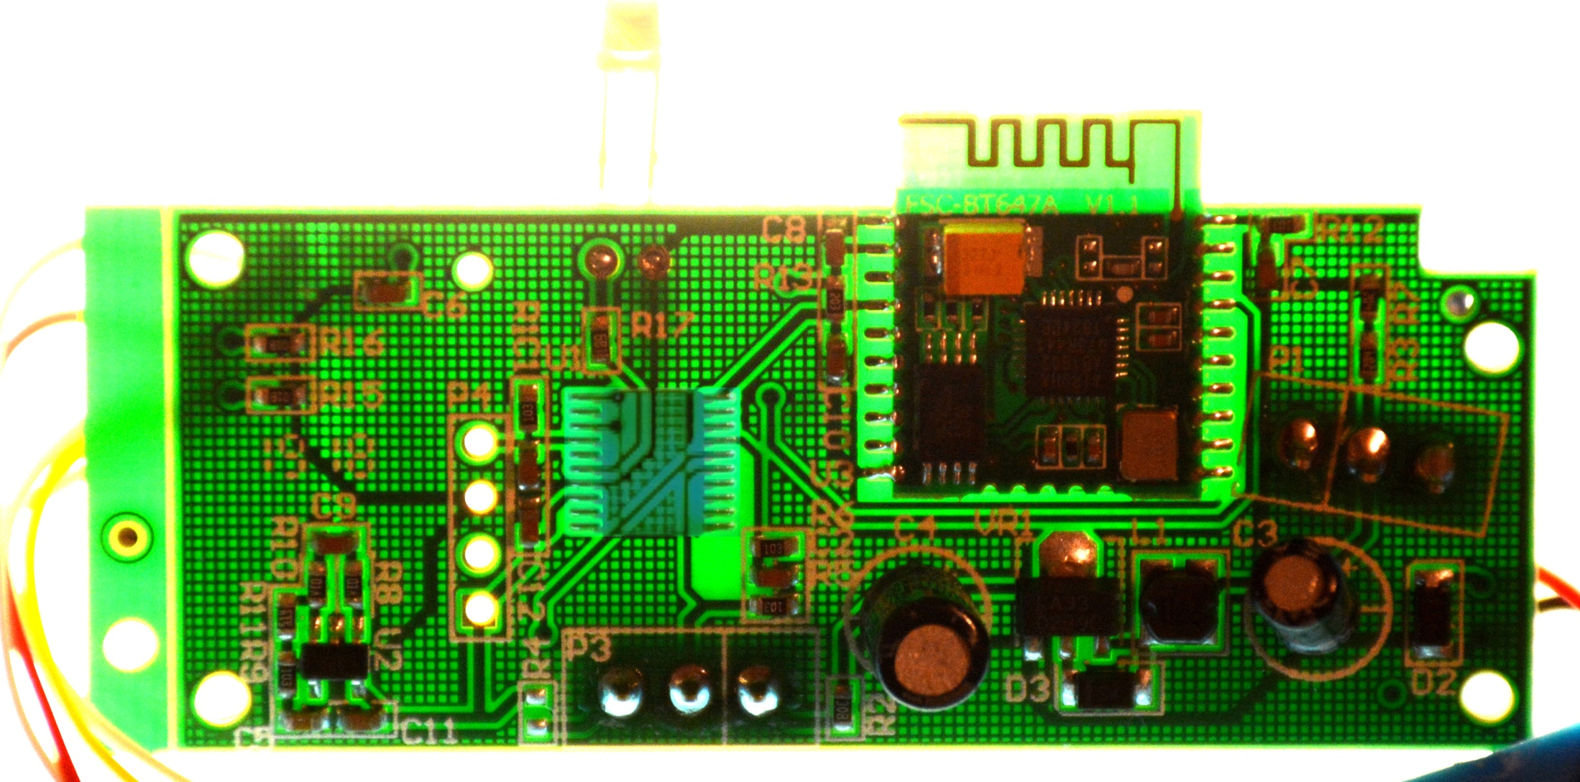
Status
LED (3.3v=on)
Analog
Weight
Reading
3.3v
(attach GPIO
for switched
sensor power)
Ground
Desolder
Microcontroller
Desolder
Bluetooth Board
3.3v
(attach to
power the
ESP8266)

Slide 3
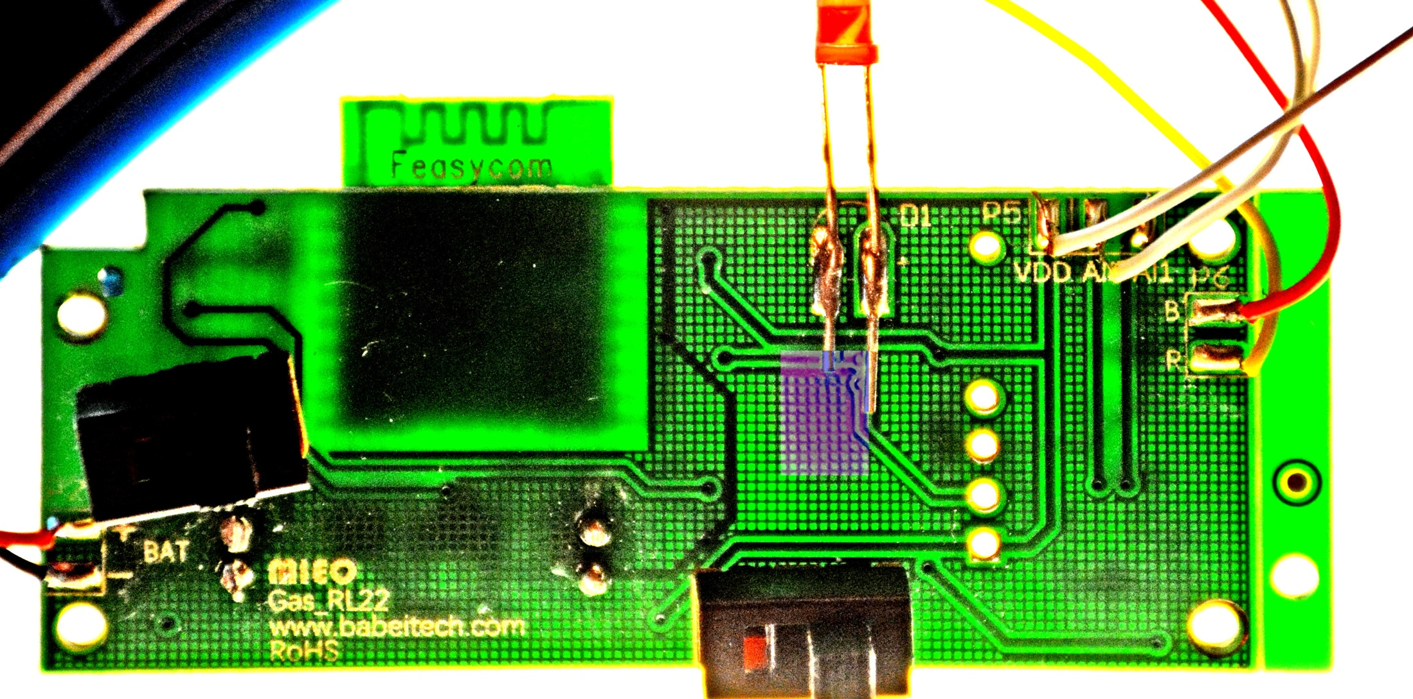
X
NOTE:
Regulated 3.3v
(supplies power
to the trace I
said to cut)
Sensor 3.3v Pwr Ground
Tap these points
to install capacitor
for sensor stability, and
to power temp sensor
Cut this 3.3v
trace to allow
switched power
to sensors
Unused switch – keep to
this position to avoid
power drain, was to old
microcontroller pull-up

Slide 4
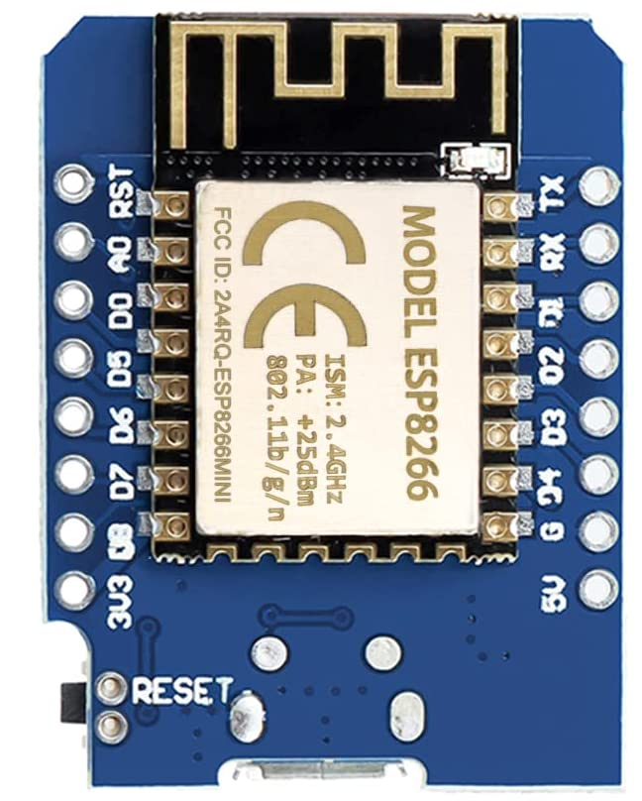
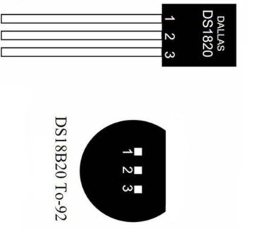
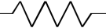
ESP8266 D1 Mini
Jump to D0 for sleep wake →
Analog Scale Reading →
Jump to RST for sleep wake →
To Status LED →
Switched Power Out To Sensors →
Data from Temp Sensor →
← GROUND
Regulated 3.3V Power →
GND
Data
USB
(Power/Programming)
4.7K
Ohms
Pull-Up
3.3V

